Slide 1

Welcome to
Maidenbower Junior School

Slide 2



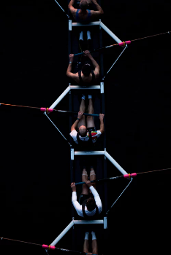
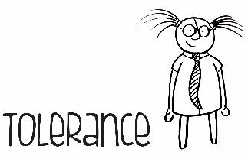
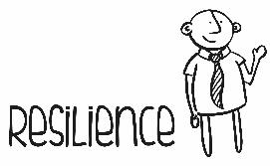


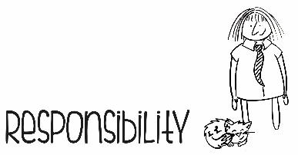
What might YOU be looking for in a school?

Slide 3
What might BUSINESSES be looking for?
When we look further ahead and into the world of work, businesses tell us that these skills are vital foundations. We emulate these at MJS.

Slide 4

What makes us special?
Good leadership (as cited by Ofsted)
Children make GOOD progress (Ofsted)
SAT’s: Reading, writing and maths higher than the local authority and National levels
The senior leadership team and governing body set high expectations of pupils and staff and lead by example to create a culture of respect and tolerance. The positive relationships between leaders, staff, pupils and parents supports the progress of all pupils at the school.

Slide 5


What makes our learning special?
A strong community with the same vision for learning
Specialist Leaders in Education (SLE’s)
Aspiring aim - to be a beacon of excellence
Positive learning behaviours
Many trips and residential opportunities
Excellent transitions from Yr 2 – Yr 3 and Yr 6 – 7
Creative and connected curriculum with business links

Slide 6
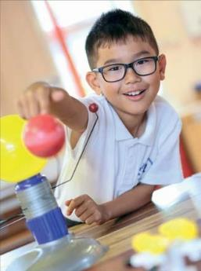
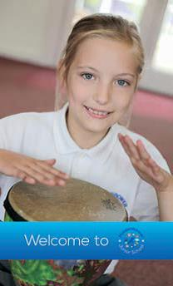
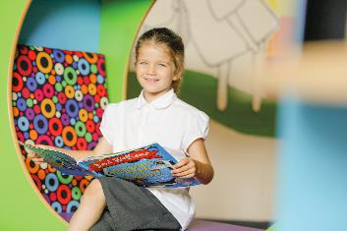
Our love of learning across the broader curriculum…
‘Well planned, exciting and inspiring curriculum’ (Ofsted).
There are a variety of ways for children to get involved in their learning. We have a topic based approach to learning which the children enjoy with lots of opportunities for outside learning. Residential trips take place for Year 4 and 6.

Slide 7
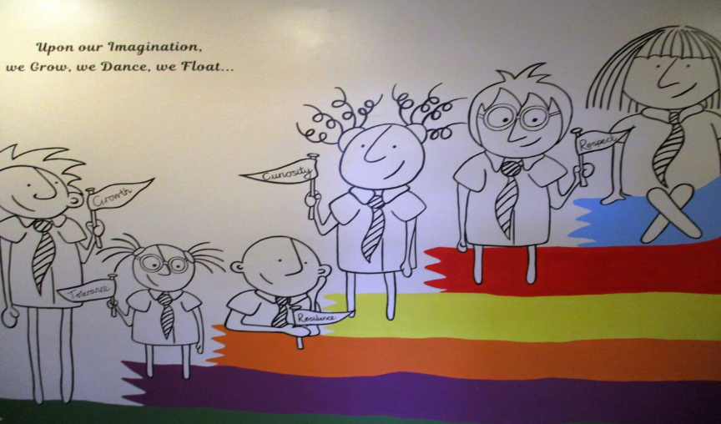
Vision and Values

Slide 8
Vision and Values
We have a clear vision at MJS which is centred around our core values. We have six key values– responsibility, respect, growth, tolerance, curiosity and resilience. Each core value is linked to a character and colour. Every Monday an assembly, focussed on our values, is taken and children are awarded a values certificate if they have demonstrated any of the six values. This is one of the many ways in which we celebrate and promote positive behaviour.
MJS also use marbles in a jar for good choices, which earns the whole class ‘golden time’. Stars of the week are highlighted in year group assemblies and children earn merits and house points for themselves and their house.
Stickers and stamps are also used with children.

Slide 9
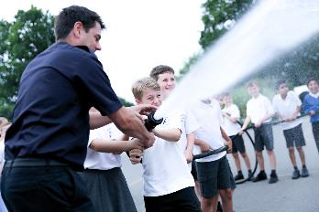
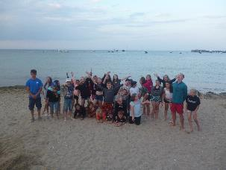
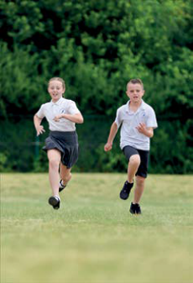
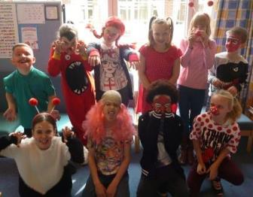
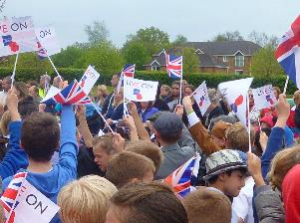
Pupils that are happy and whom we are proud of…
We trust and give responsibility to our pupils through encouraging them to get involved with school life. MJS have a school leadership team, digital reps, eco reps, a sports crew and house captains.

Slide 10
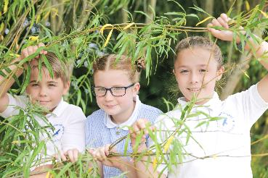
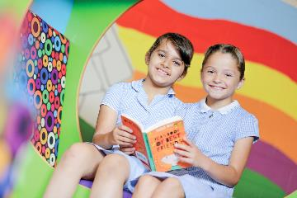
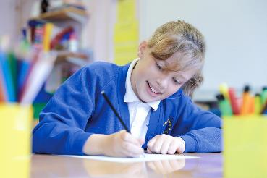
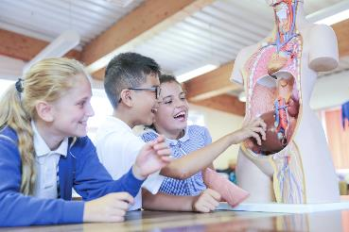
Strive to be the best we can be…
We offer ways in which all children can shine whether in sports competitions or solo activities, through sporting achievements, music certificates, art projects, maths and reading competitions and many more.

Slide 11
Our promise – Your child will;
Be treated as an individual
Learn alongside personable and approachable staff
Develop confidence; work as part of a team
Gain excellent knowledge and improvement in English and Maths (Schools come to see us in action)
Experience, learn about and enjoy a wide range of subjects
Learn through real life experiences, transferable skills and businesses
Have their strengths recognised and developed

Slide 12
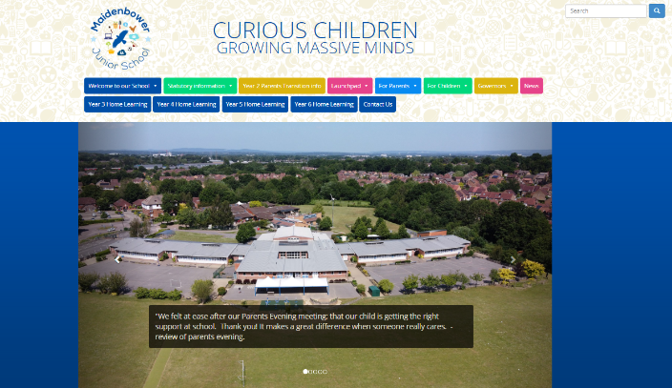
Our web-site
Feel free to view our virtual tour around the school on our Maidenbower Junior School website
…or contact our School Leadership Team;
Elaine Jenkins – Head teacher
Kerry Negus – Deputy Head teacher supporting Y3 and Y4
Simon Pike - Deputy Head teacher supporting Y5 and Y6
Stephen Turnbull – Inclusion manager
Chris Buckley – Learning Lead for ‘The Launchpad’ – provision for children with a diagnosis of autism.
Contact phone number: 01293 883758
Email address: office@maidenbowerjunior.w-sussex.sch.uk

Slide 13
What happens now?
Your admission choices should be sent to County (online) by January 15th 2022
COVID-19 permitting;
Open Afternoon– Thursday 16th June from 4.30 – 7.00pm
Parents with Year 2 children Meeting – to be confirmed in the summer term 2022

Slide 14

To summarise;
We are proud of our school and the staff within it.
We are a true community school at the heart of Maidenbower with parents, staff, children and governors all working towards a common goal.
Our vision for education is to give every child the best chance in life with learning and values at its heart.
We have here, a safe and healthy learning community, where children as well as adults are happy, excited, challenged and inspired to be lifelong learners.

Slide 15
